Slide 1
Variational Inference with Normalizing Flows
E. Burnaev, Skoltech

Slide 2
Outline
Generative Models
VI revisited
Deep Latent Models
Normalizing Flows (Rezende, ICML 2015)
Inference with Normalizing Flows
Tractable Architectures for Normalizing Flows (Dinh, ICLR 2017)
Theoretical Concepts: Infinitesimal Flows

Slide 3
Outline
Generative Models
VI revisited
Deep Latent Models
Normalizing Flows (Rezende, ICML 2015)
Inference with Normalizing Flows
Tractable Architectures for Normalizing Flows (Dinh, ICLR 2017)
Theoretical Concepts: Infinitesimal Flows

Slide 4
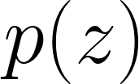
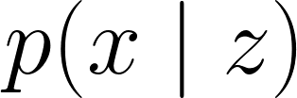
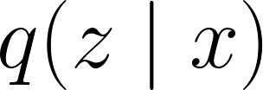
Variational Auto-Encoders
Prior distribution: p(z)
Emission distribution: p(x | z)
Approximate posterior: q(z | x)
Z
Difficult to match approximate and true posterior
Prone to blurry samples
X
[Kingma and Welling, 2013] [Rezende et al., 2014]

Slide 5
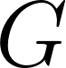

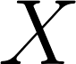
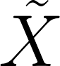
Generative Adversarial Networks
Z
Generator network:
Discriminative network:
Discriminate X and X with
G
X
~
X
Instability in training, mode collapse, no tractable measure of performance
D
D
[Goodfellow et al., 2014]

Slide 6
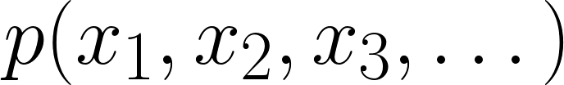
Auto-Regressive Models
Probability decomposition:
p(x1, x2, x3, …)
= p(x1)p(x2 | x1)p(x3 | x1, x3) …
No global latent space and sequential sampling
X1
X2
X3
[Frey,1998] [Larochelle and Murray, 2011] [Germain, 2015] [Oord, 2016]

Slide 7
Outline
Generative Models
VI revisited
Deep Latent Models
Normalizing Flows (Rezende, ICML 2015)
Inference with Normalizing Flows
Tractable Architectures for Normalizing Flows (Dinh, ICLR 2017)
Theoretical Concepts: Infinitesimal Flows

Slide 8
Problems of VI
VI for complex problems on increasingly larger data sets
Limitation of VI: choice of posterior class
Even in asymptotic regime we are unable to recover the true posterior

Slide 9
Problems of VI
VI for complex problems on increasingly larger data sets
Limitation of VI: choice of posterior class
Even in asymptotic regime we are unable to recover the true posterior
Richer posterior approximation -> better performance
Poor posterior approximation from a limited capacity class:
Under-estimation of the variance
Biases in MAP estimates

Slide 10
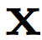
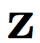
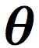
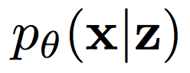
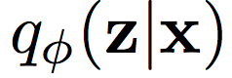
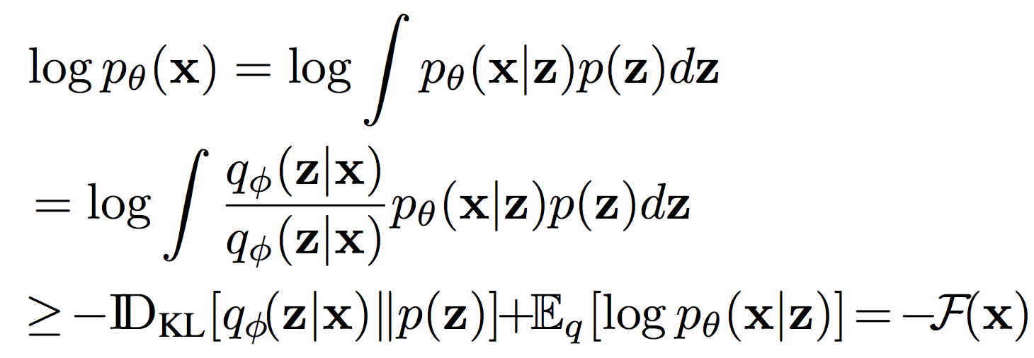
ELBO
- observations
- latent variables
- model parameters
- likelihood
- approximate posterior distribution for the latent variables

Slide 11
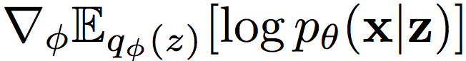
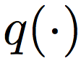
Amortized Variational Inference
There are two problems to address
Efficient computation of
choosing the richest, computationally-feasible approximate posterior distribution

Slide 12
Amortized Variational Inference
There are two problems to address
Efficient computation of
choosing the richest, computationally-feasible approximate posterior distribution
To address the first problem, we use two tools:
Monte Carlo gradient estimation and
inference networks,
which when used together is referred to as
amortized variational inference

Slide 13
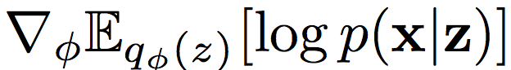
Stochastic Backpropagation
Compute the gradient of the expected log-likelihood
Doubly-stochastic estimation:
Mini-batches
Monte-Carlo approximation for the expectation

Slide 14
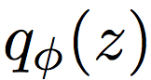
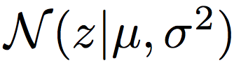
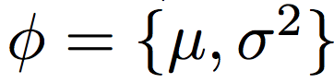
Stochastic Backpropagation
Compute the gradient of the expected log-likelihood
Reparameterization
E.g. is a with

Slide 15
Stochastic Backpropagation
Compute the gradient of the expected log-likelihood
Reparameterization
E.g. is a with
Backpropagation with Monte Carlo

Slide 16
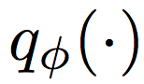
Inference Networks
The approximate posterior is represented as inference network
Inference Network learns inverse map from observations to latent variables

Slide 17
Inference Networks
The approximate posterior is represented as inference network
Inference Network learns inverse map from observations to latent variables
We avoid computing per data point variational parameters to approximate the distribution of
We can instead compute a set of global variational parameters

Slide 18
Inference Networks
The approximate posterior is represented as inference network
Inference Network learns inverse map from observations to latent variables
We avoid computing per data point variational parameters to approximate the distribution of
We can instead compute a set of global variational parameters
The simplest example

Slide 19
Outline
Generative Models
VI revisited
Deep Latent Models
Normalizing Flows (Rezende, ICML 2015)
Inference with Normalizing Flows
Tractable Architectures for Normalizing Flows (Dinh, ICLR 2017)
Theoretical Concepts: Infinitesimal Flows

Slide 20
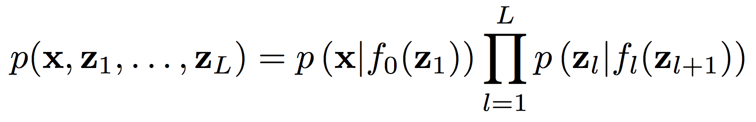
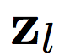
Deep Latent Gaussian Models (DLGM)
layers of Gaussian latent variables for layer
Non-linear dependency between layers is specified by deep neural networks

Slide 21
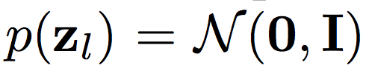
Deep Latent Gaussian Models (DLGM)
layers of Gaussian latent variables for layer
Non-linear dependency between layers is specified by deep neural networks
The prior over latent variables is a unit Gaussian
Includes other models such as factor analysis and PCA, non-linear factor analysis, etc.

Slide 22
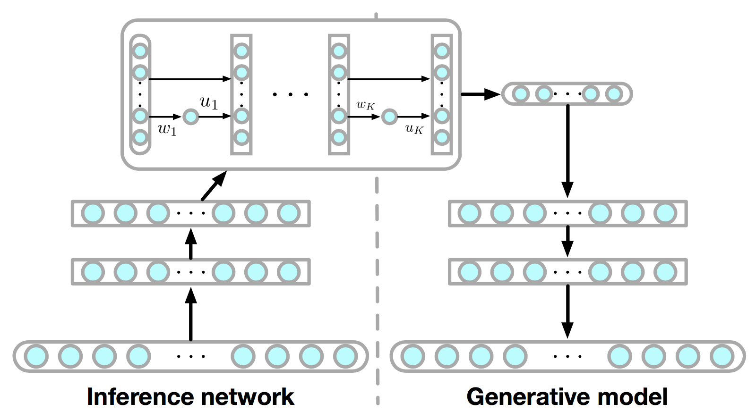
Deep Latent Gaussian Models (DLGM)
The end-to-end system of DLGM and inference network can be viewed as an encoder-decoder architecture (aka variational autoencoder)

Slide 23
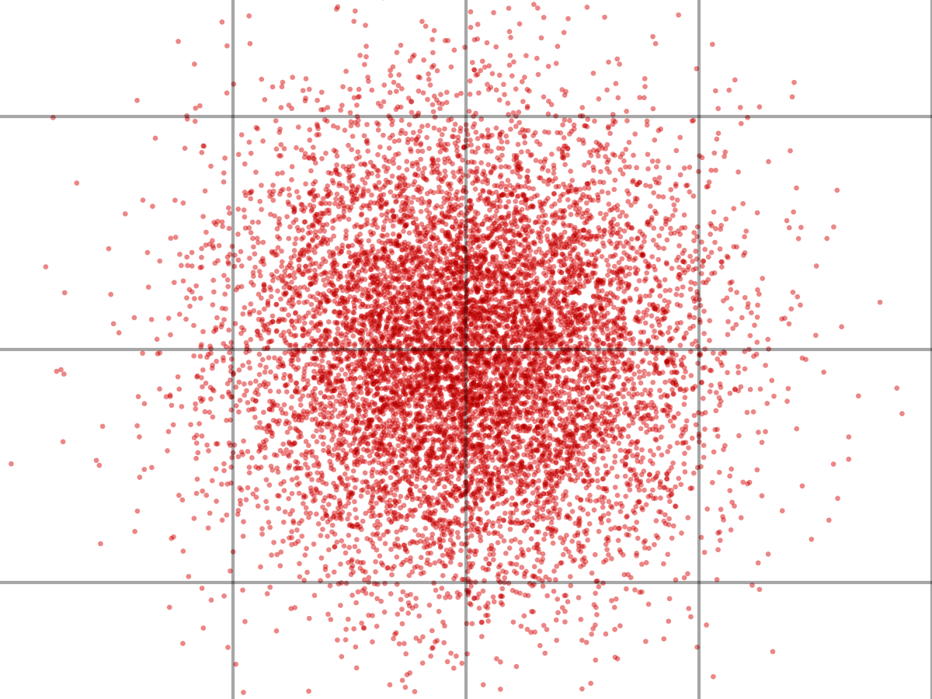
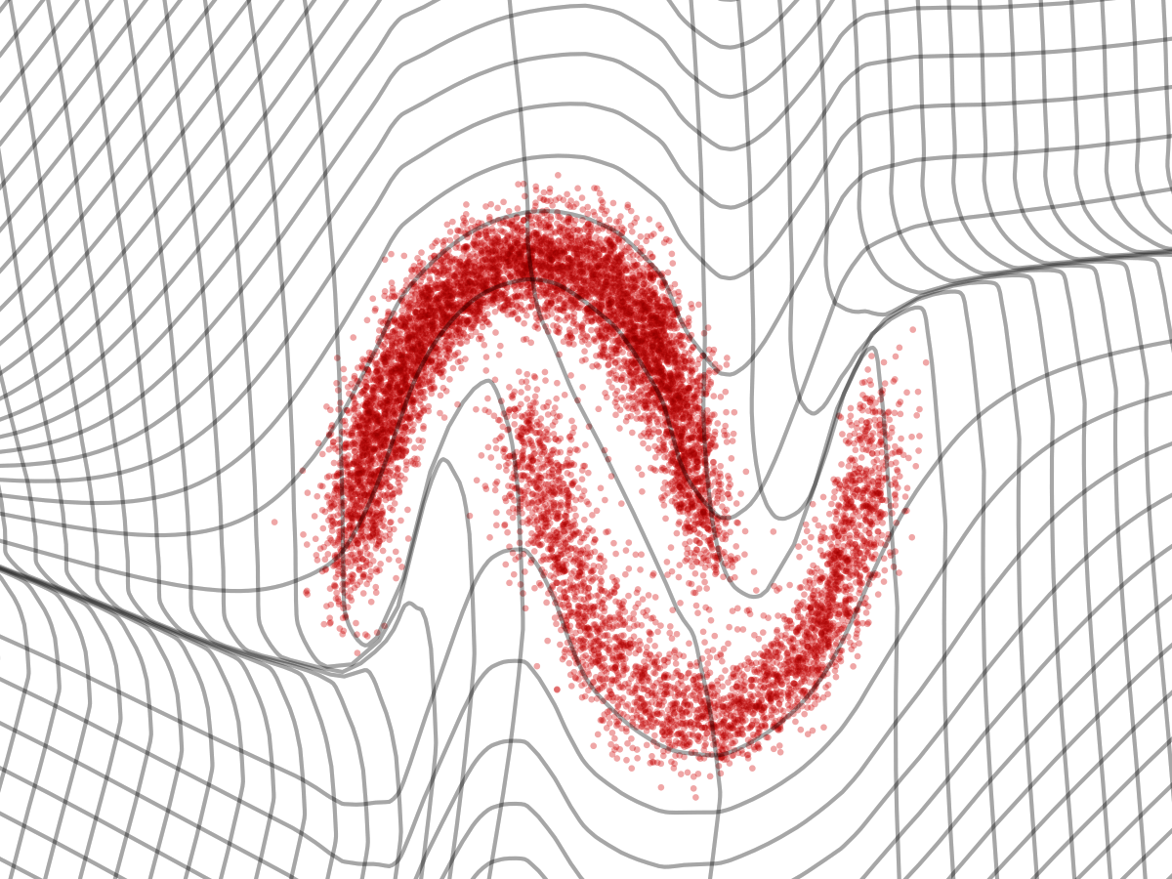
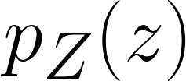
One-pass generative model
z
x
inference
g
g(∙) – is a flow that transforms a simple density of z to some complex density of x

Slide 24
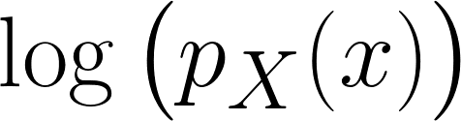
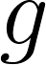
Train via maximum likelihood
Maximize f
with respect to

Slide 25
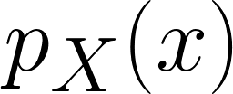
Train via maximum likelihood
Maximize f
with respect to
… but how do we evaluate p_X(x)?

Slide 26
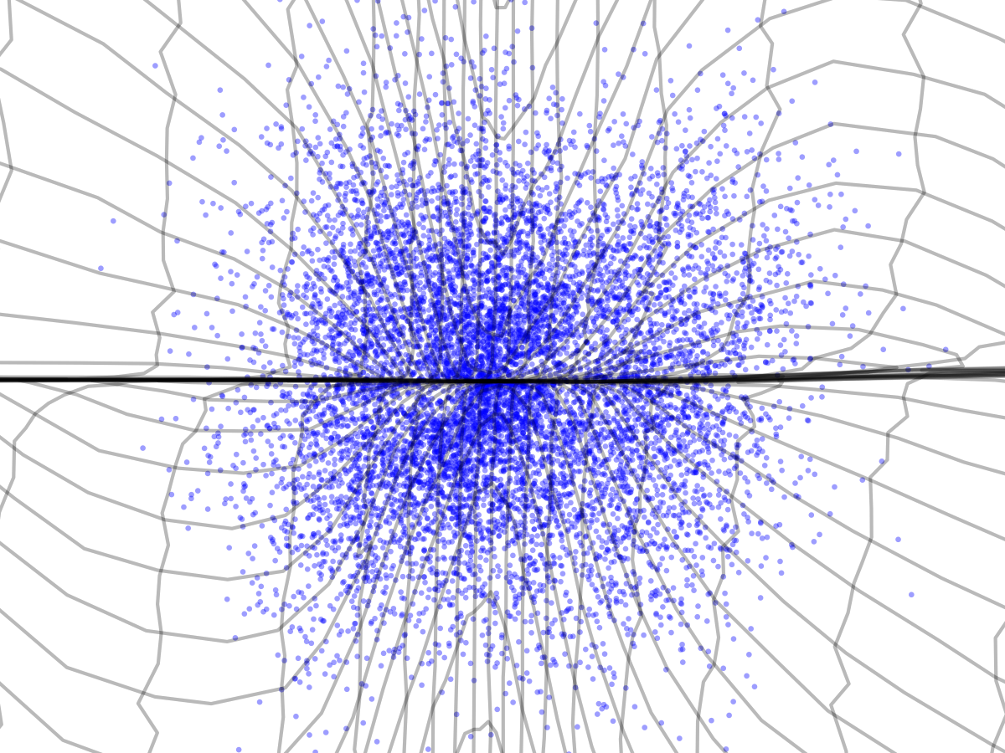
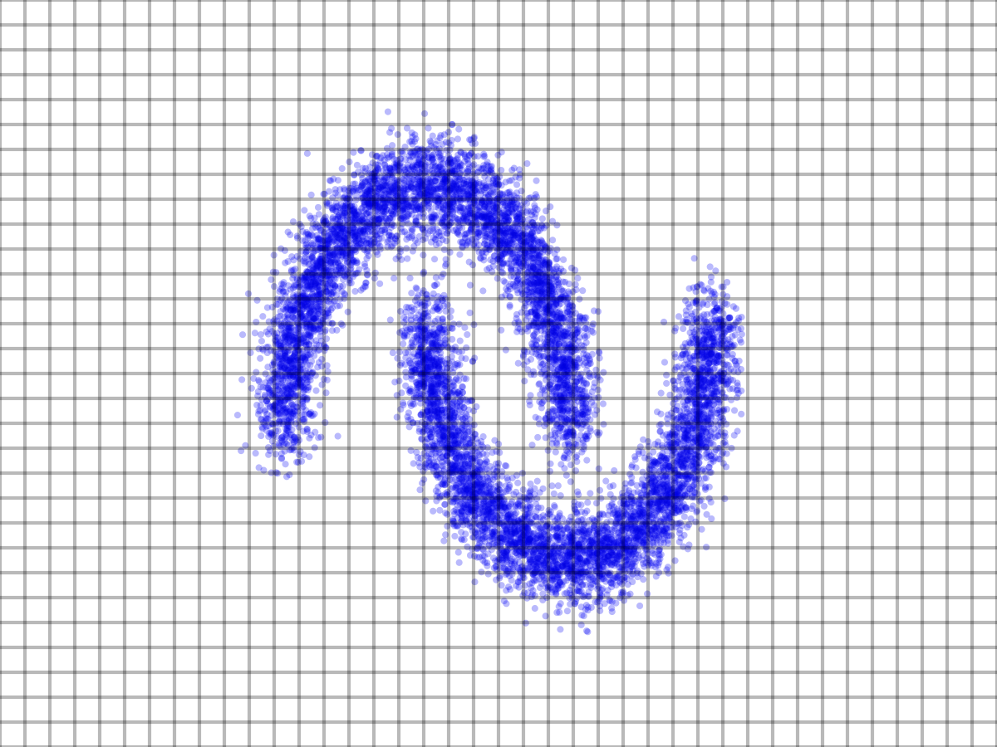
Inference via inverse transform
z
x
? ? ? ?
g

Slide 27
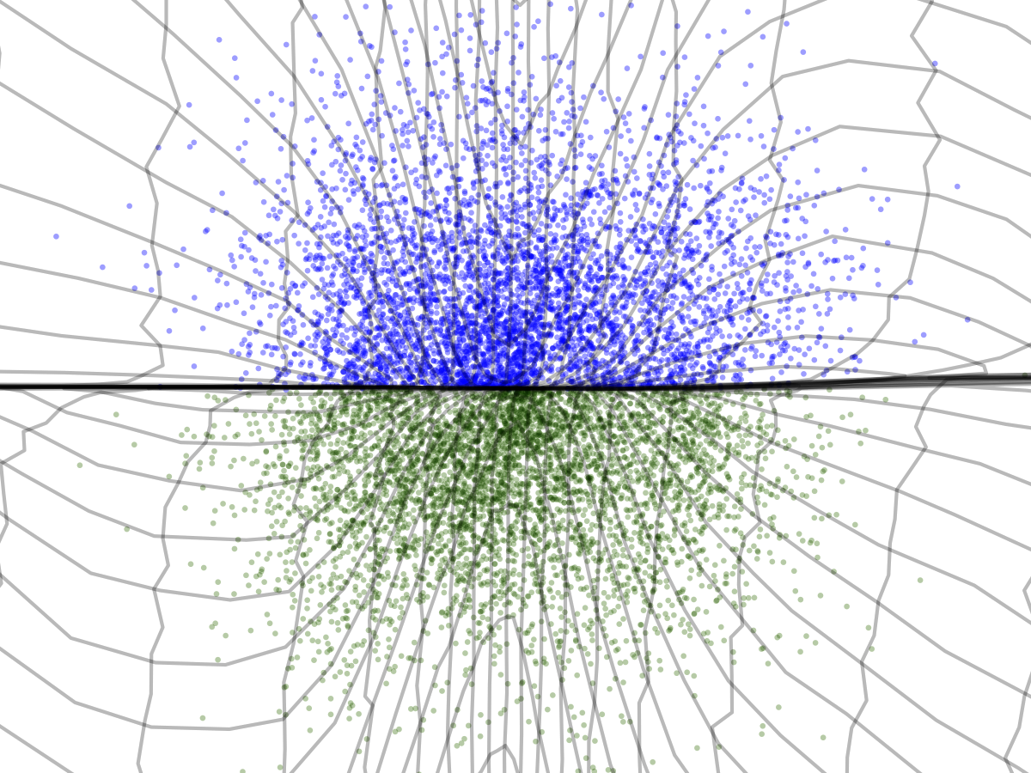
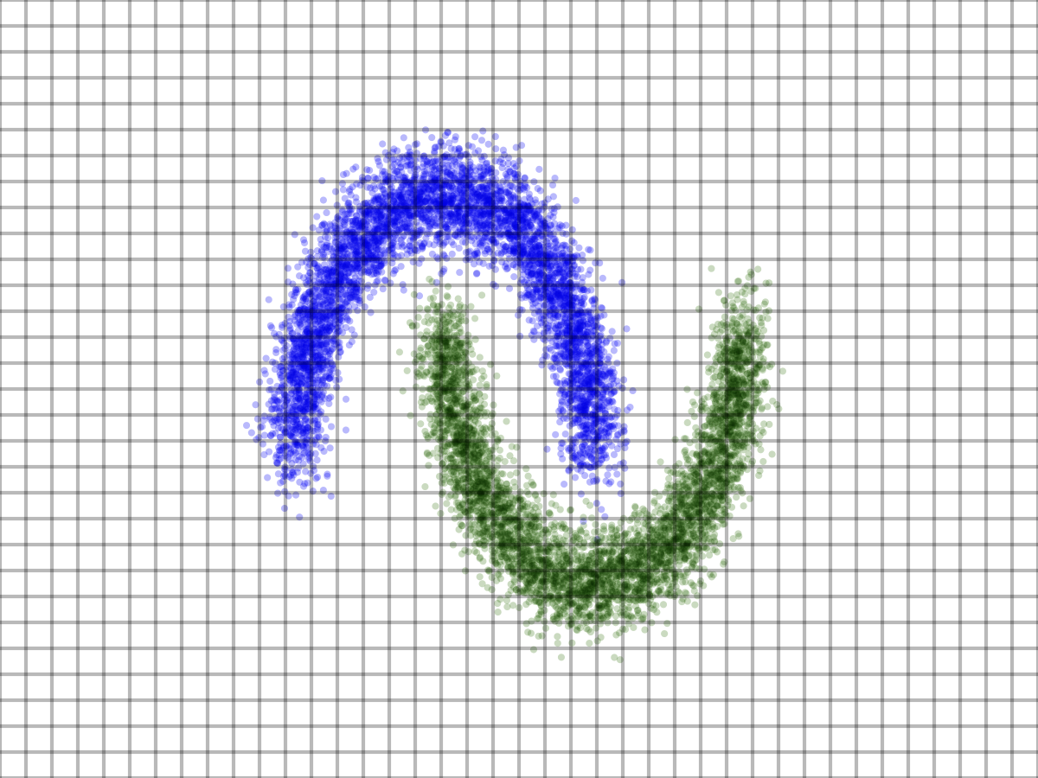
Inference via inverse transform
z
x
g
-1
g

Slide 28
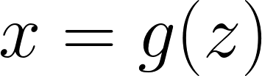
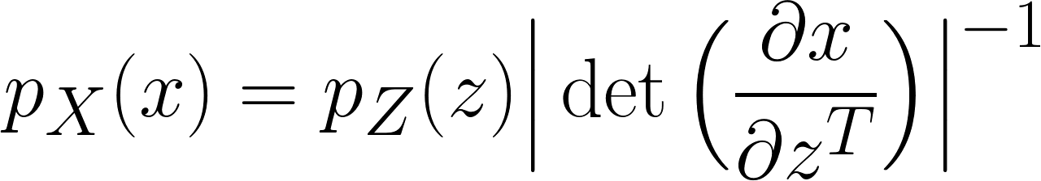
Change of variable formula
f invertible
z
x
Probability under prior
Volume change going from z to x

Slide 29
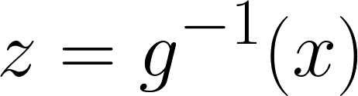
Change of variable formula
f invertible
z
x
Probability under prior
Volume change going from z to x

Slide 30
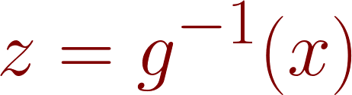
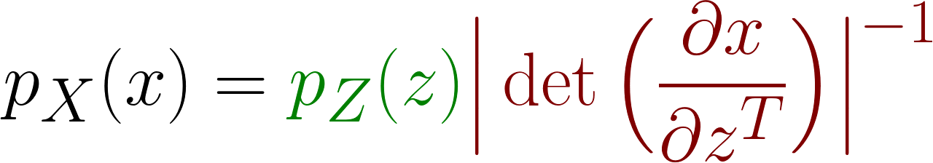
Change of variable formula
f invertible
z
x
Probability under prior
Volume change going from z to x

Slide 31
Change of variable formula
f invertible
z
x
Probability under prior
gaussian
Volume change going from z to x

Slide 32
Change of variable formula
Deep neural network
f invertible
z
x
Probability under prior
gaussian
Volume change going from z to x

Slide 33
Outline
Generative Models
VI revisited
Deep Latent Models
Normalizing Flows (Rezende, ICML 2015)
Inference with Normalizing Flows
Tractable Architectures for Normalizing Flows (Dinh, ICLR 2017)
Theoretical Concepts: Infinitesimal Flows

Slide 34
Normalizing Flows
A normalizing flow describes the transformation of a probability density through a sequence of invertible mappings

Slide 35
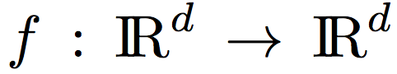
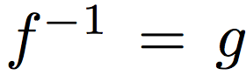
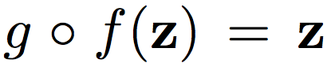
Normalizing Flows
A normalizing flow describes the transformation of a probability density through a sequence of invertible mappings
Finite flows
with inverse

Slide 36
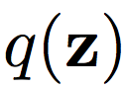
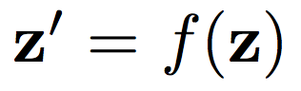
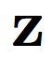
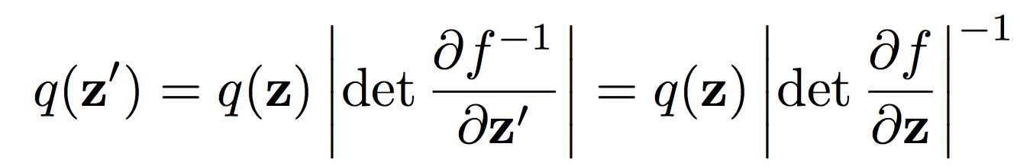
Normalizing Flows
A normalizing flow describes the transformation of a probability density through a sequence of invertible mappings
Finite flows
with inverse
Transform ~ with

Slide 37
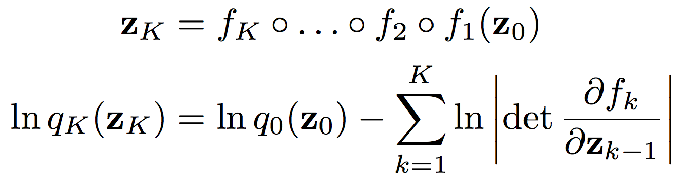
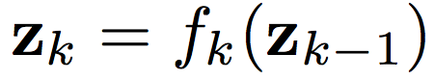
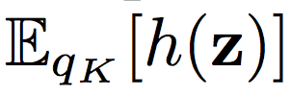
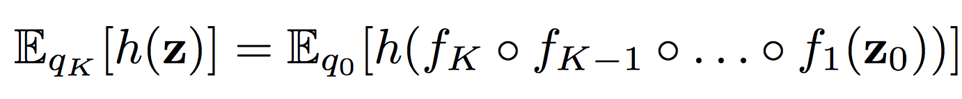
Finite Normalizing Flows
We denote by
. Then
Any expectation
The effect of invertible flows as a sequence of expansions or contractions on the initial density

Slide 38
Outline
Generative Models
VI revisited
Deep Latent Models
Normalizing Flows (Rezende, ICML 2015)
Inference with Normalizing Flows
Tractable Architectures for Normalizing Flows (Dinh, ICLR 2017)
Theoretical Concepts: Infinitesimal Flows

Slide 39


Planar Flows
Invertible Linear-time Transformations
Thanks to matrix determinant lemma
we can compute logdet-Jacobian term in O(D) time:

Slide 40


Inference with Normalizing Flows
Final density
Modifies the initial density by applying a series of contractions and expansions w.r.t. the directions (planar flows)

Slide 41



Radial Flows
A family of transformations that modify an initial density around a reference point
where

Slide 42

Planar flows

Slide 43

Radial flows

Slide 44




Flow-Based Free Energy Bound
We parameterize the approximate posterior distribution with a flow of length
For amortized VI we construct an inference model using a deep NN:
mapping from the observations
to the parameters of the initial density
to the parameters of the flow

Slide 45


Flow-Based Free Energy Bound

Slide 46

Variational Inf. with Normalizing Flows

Slide 47

Bayesian Inference
Computing log-det-Jacobians
Here
is the number of deterministic layers used to map the data to the parameters of the flow,
is the average hidden layer size,
is the flow-length and
is the dimension of the latent variables

Slide 48



Experiments

Slide 49




Tips and Tricks
A simple annealed version of the free energy with inverse temperature

Slide 50
Tips and Tricks
The DNNs that form the conditional probability between random variables consist of
deterministic layers with 400 hidden units using
the Maxout non-linearity on windows of 4 variables
We use mini-batches of 100 data points and RMSprop optimization (with learning rate = 10⁻⁵ and momentum = 0.9)

Slide 51

Experiments

Slide 52

Experiments

Slide 53

Experiments (modeling of distributions)

Slide 54

Experiments (VI to approximate posterior based on NF)

Slide 55

MNIST (VI to approximate posterior based on NF)
We trained different DLGMs with 40 latent variables for 500,000 parameter updates

Slide 56

MNIST

Slide 57
Outline
Generative Models
VI revisited
Deep Latent Models
Normalizing Flows (Rezende, ICML 2015)
Inference with Normalizing Flows
Tractable Architectures for Normalizing Flows (Dinh, ICLR 2017)
Theoretical Concepts: Infinitesimal Flows

Slide 58


Coupling Layer
y1
y2
x
=
s
+
t
x1
x2

Slide 59

Coupling Layer
Y1 = X1
Y2 = (X2 + t(X1)) * exp(s(X1))
y1
y2
x
=
s
+
t
x1
x2

Slide 60
Properties of the Coupling Layer

Slide 61
Properties of the Coupling Layer
Easy, stable, inverse

Slide 62

Properties of the Coupling Layer
Easy, stable, inverse

Slide 63
Properties of the Coupling Layer
Easy, stable, inverse

Slide 64
Properties of the Coupling Layer
Easy, stable, inverse

Slide 65
Properties of the Coupling Layer
Easy, stable, inverse
Tractable Jacobian determinant

Slide 66

Properties of the Coupling Layer
Easy, stable, inverse
Tractable Jacobian determinant

Slide 67
Properties of the Coupling Layer
Easy, stable, inverse
Tractable Jacobian determinant
Triangular --> easy to calculate

Slide 68

General Case

Slide 69


General Case: Inverse

Slide 70


General Case: Determinant
So far, the affine coupling layer looks perfect for constructing a normalizing flow :)

Slide 71

Masked Convolution

Slide 72
Combining Coupling Layers
Although coupling layers can be powerful, their forward transformation leaves some components unchanged
This difficulty can be overcome by composing coupling layers in an alternating pattern
The components that are left unchanged in one coupling layer are updated in the next

Slide 73

Combining Coupling Layers

Slide 74


Combining Coupling Layers
The Jacobian determinant of the resulting function remains tractable, relying on the fact that
Similarly, its inverse can be computed easily as

Slide 75


Qualitative results (CIFAR-10)
DRAW
Real NVP

Slide 76


Qualitative results (Imagenet 64x64)
Convolutional DRAW
Real NVP

Slide 77


Qualitative results
LSUN (bedroom)
Imagenet

Slide 78

Qualitative results (Imagenet 64x64)
Multi-scale Pixel RNN
Real NVP

Slide 79

Qualitative results (Imagenet 64x64)
http://goo.gl/yco14s

Slide 80

Qualitative results (CelebA)
http://goo.gl/yco14s

Slide 81



More qualitative results
http://goo.gl/yco14s

Slide 82
Outline
Generative Models
VI revisited
Deep Latent Models
Normalizing Flows (Rezende, ICML 2015)
Inference with Normalizing Flows
Tractable Architectures for Normalizing Flows (Dinh, ICLR 2017)
Theoretical Concepts: Infinitesimal Flows

Slide 83
“Discrete” Normalizing Flows
Invertible Linear-time Transformations
Final density

Slide 84


Infinitesimal Flows
The length (depth of the composition of transformations) of the normalizing flow tends to infinity
Partial differential equation describing how the initial density
evolves over time

Slide 85






Langevin Flow
Langevin SDE
is a Wiener process with
is the drift process
is the diffusion matrix

Slide 86



Kolmogorov Equation
We transform ~ through the Langevin flow
The density of the transformed sample evolves as (Kolmogorov equation)

Slide 87





Bayesian Inference with Langevin Flows
Let
be is an unnormalised log-density
E.g. is a log-posterior of
How to sample from ?
1. We set ,
2. The stationary solution for
is given by the Boltzmann distribution
3. We start from an initial and evolve its samples through
Langevin SDE
The resulting samples will be distributed as
, the true posterior

